Slide 1
Evaluating Hybrid KEM/DSA for KpqC and NIST PQC on ARM Cortex-M4
Minjoo Sim, Minwoo Lee, Subeen Cho, Yulim Hyoung and Hwajeong Seo
26.08.27

Slide 2
Introduction
Backgrounds
Proposed Method
Evaluation
Conclusion

Slide 3
Introduction
Advances in quantum computing threaten classical public-key algorithms such as RSA and ECC.
PQC standardization efforts are advancing worldwide.
Korea launched the KpqC competition in 2022, and four algorithms were selected in January 2025.
Deploying post-quantum cryptography requires more than selecting primitives—it also requires careful integration.
Hybrid approaches retain both classical and post-quantum components during the transition.

Slide 4
Introduction
X-Wing is a representative hybrid KEM construction.
It combines ML-KEM-768 and X25519 to derive a hybrid shared secret.
Embedded performance evaluations of broader PQC–classical combinations remain limited.
Hybrid DSA constructions have also been proposed, but empirical comparisons remain limited.

Slide 5
Contributions
Composed-Cost Attribution for Hybrid PQC
Common bare-metal Cortex-M4 harness
Fixed layouts · labels · interfaces · backends · target configuration
→ Makes classical-leg, wrapper, and shared-backend costs visible
Backend Sensitivity & Signing-Time Variability
Keccak-f[1600] backend swap → Performance changes in SHAKE-intensive schemes
Rejection sampling → Observed signing-time variability
Cycles · wire sizes · peak stack · code estimates · standalone component checks
SMAUG-T Backend & Optimization Dilution
Local Cortex-M4 SMAUG-T arithmetic backend
Standalone speedup → Diluted in SMAUG-T + X25519 compositions
Remaining fixed costs: classical operations · hashing · wrapper

Slide 6
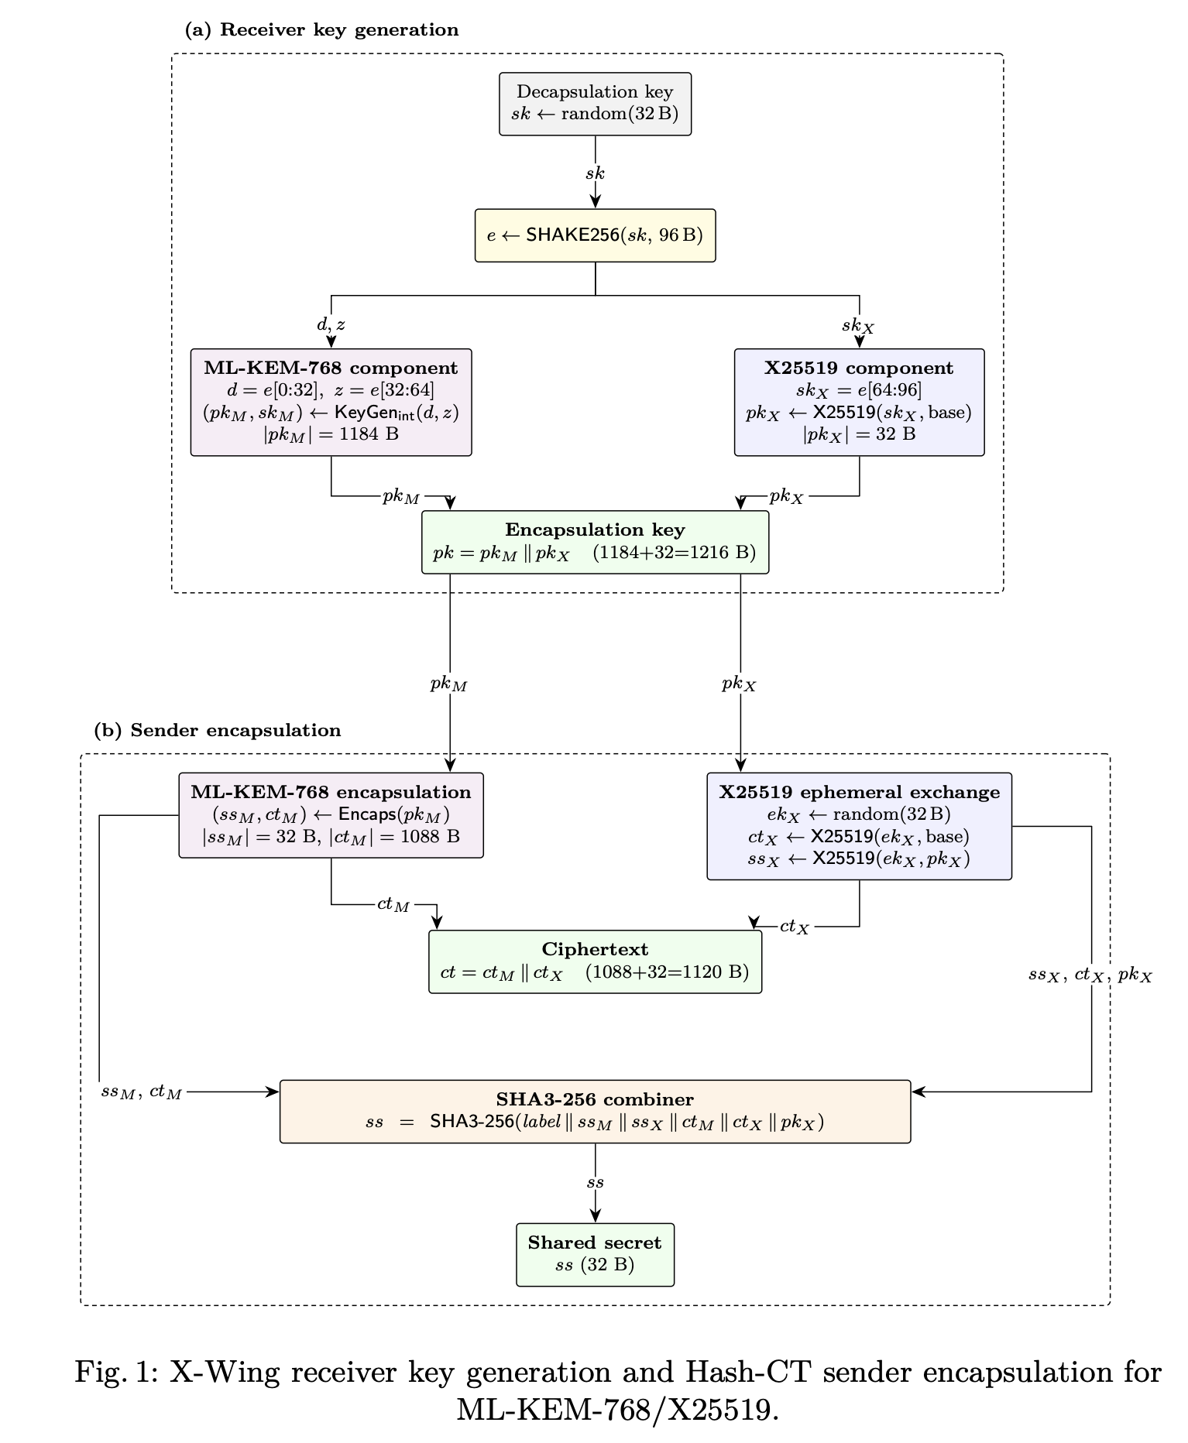
Background: X-Wing and Hash-CT QSF
X-Wing/QSF Background
X-Wing combines ML-KEM-768 and X25519.
The IETF X-Wing transcript omits the PQ ciphertext from the final combiner hash.
Hash-CT Transcript Used in This Work
Component shared secrets and transcript fields are combined using SHA3-256.
ss = SHA3-256(label || ss_pq || ss_cl || ct_pq || ct_cl || pk_cl)
The PQ ciphertext ct_pq is included.
Hash-CT is a benchmark label—not a new KEM, a new combiner standard, or the IETF X-Wing transcript.

Slide 7
Background: X-wing and Hash-CT QSF
Hybrid KEM: Evaluated Hybrid KEM Configurations
PQ KEMs: ML-KEM, NTRU+, SMAUG-T, and HQC
Primary classical partner: X25519 (P-256 control)
Component algorithms left unmodified
Wrapper-level composition
Common harness → Direct composed-cost comparison across KpqC and NIST schemes

Slide 8
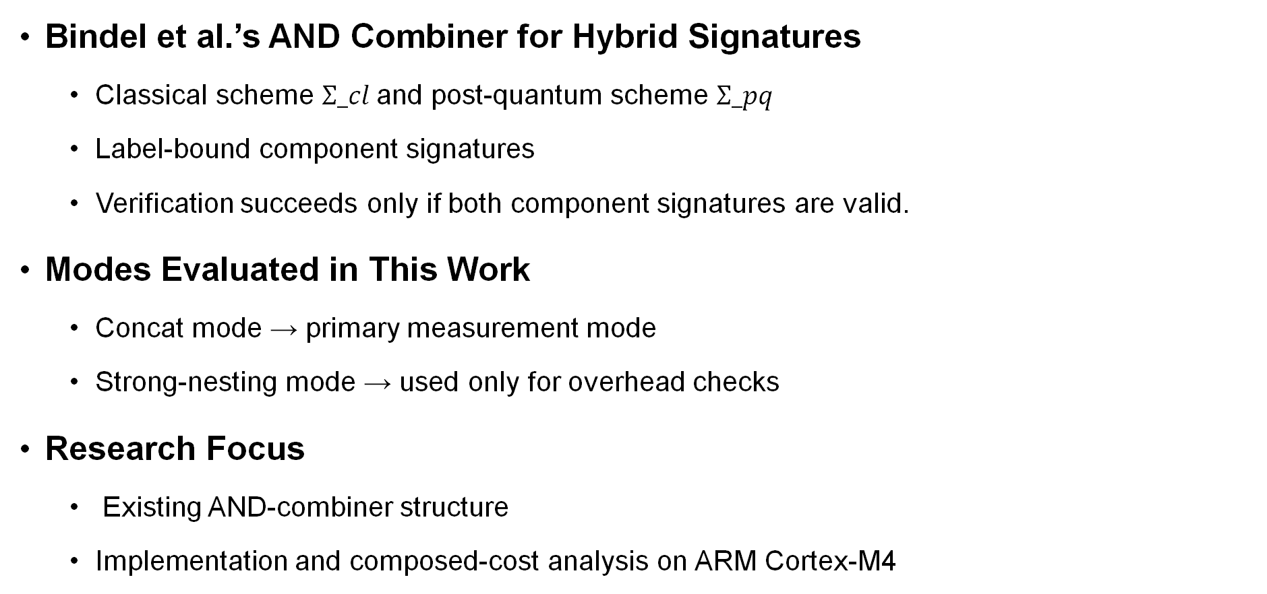
Background: Hybrid Signature Combiner
Bindel et al.’s AND Combiner for Hybrid Signatures
Classical scheme $Σ_cl$and post-quantum scheme $Σ_pq$
Label-bound component signatures
Verification succeeds only if both component signatures are valid.
Modes Evaluated in This Work
Concat mode → primary measurement mode
Strong-nesting mode → used only for overhead checks
Research Focus
Existing AND-combiner structure
Implementation and composed-cost analysis on ARM Cortex-M4

Slide 9
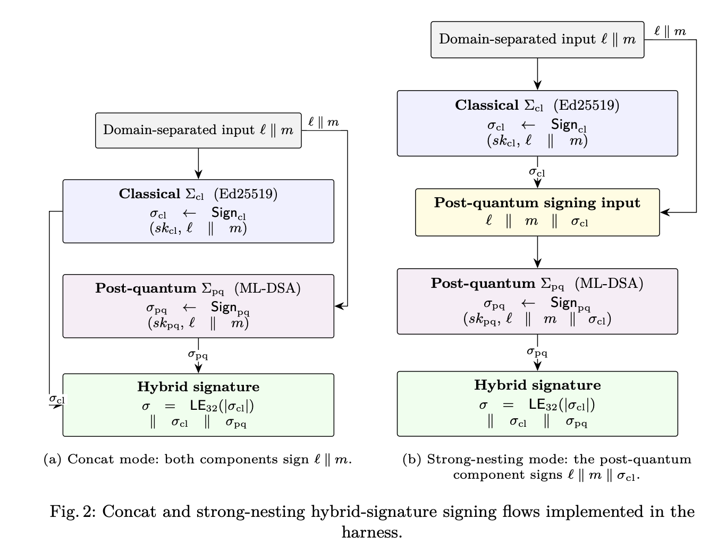
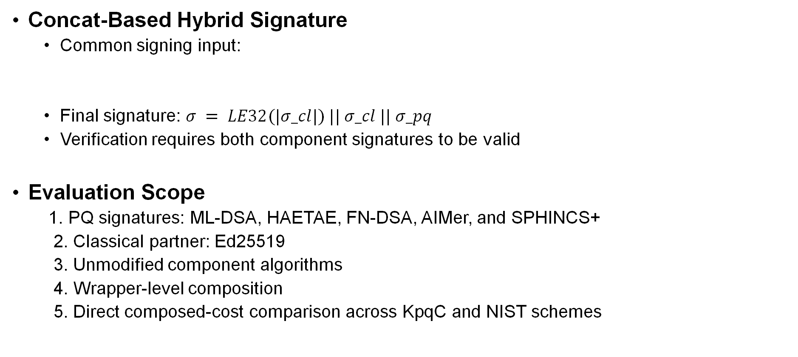
Hybrid Signature: Concat Mode
Concat-Based Hybrid Signature
Common signing input:
Final signature: $σ = LE32(|σ_cl|) || σ_cl || σ_pq$
Verification requires both component signatures to be valid
Evaluation Scope
1. PQ signatures: ML-DSA, HAETAE, FN-DSA, AIMer, and SPHINCS+
2. Classical partner: Ed25519
3. Unmodified component algorithms
4. Wrapper-level composition
5. Direct composed-cost comparison across KpqC and NIST schemes

Slide 10
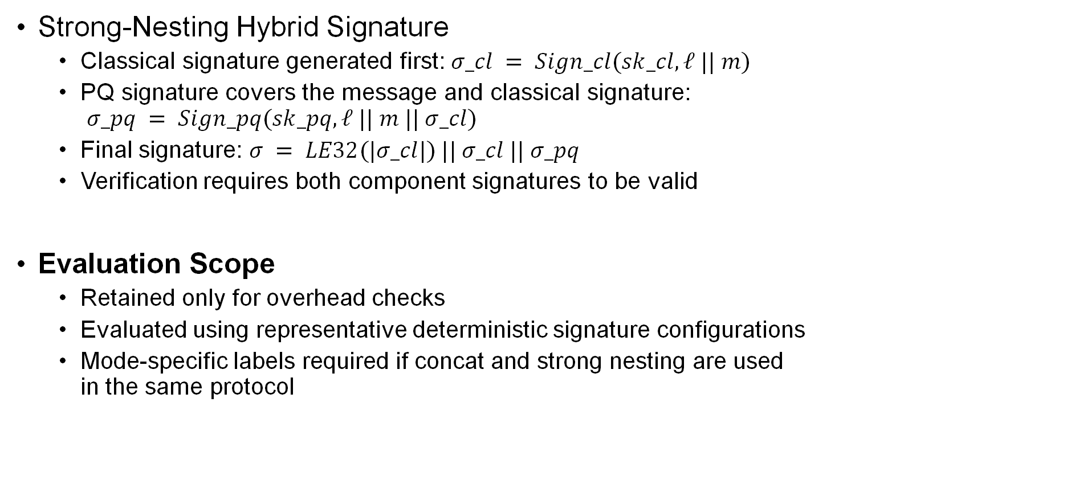
Hybrid Signature: Strong-Nesting Mode
Strong-Nesting Hybrid Signature
Classical signature generated first: $σ_cl = Sign_cl(sk_cl, ℓ || m)$
PQ signature covers the message and classical signature: $σ_pq = Sign_pq(sk_pq, ℓ || m || σ_cl)$
Final signature: $σ = LE32(|σ_cl|) || σ_cl || σ_pq$
Verification requires both component signatures to be valid
Evaluation Scope
Retained only for overhead checks
Evaluated using representative deterministic signature configurations
Mode-specific labels required if concat and strong nesting are used in the same protocol

Slide 11
Experimental Setup
Target board: NUCLEO-L4R5ZI (ARM Cortex-M4, 20MHz)
Framework: pqm4
Memory: 640 KB SRAM and 2 MB flash
Compiler: arm-none-eabi-gcc 13.2.1
Primary measurements: median cycle counts over 100 executions
Component | Measured Backend
Hybrid composition | (Ours) Hash-CT KEM and AND-combiner wrappers
PQC implementations | PQClean, pqm4, mupq, and KpqClean Ver2 with Cortex-M4 backends
SMAUG-T | (Ours) polynomial-multiplication assembly
Classical primitives | Lenngren X25519/P-256 assembly TweetNaCl Ed25519 C mbedTLS-C ECDSA-P256
Symmetric primitives | Assembly Keccak-f[1600] and ARMv7-M SHA-256

Slide 12
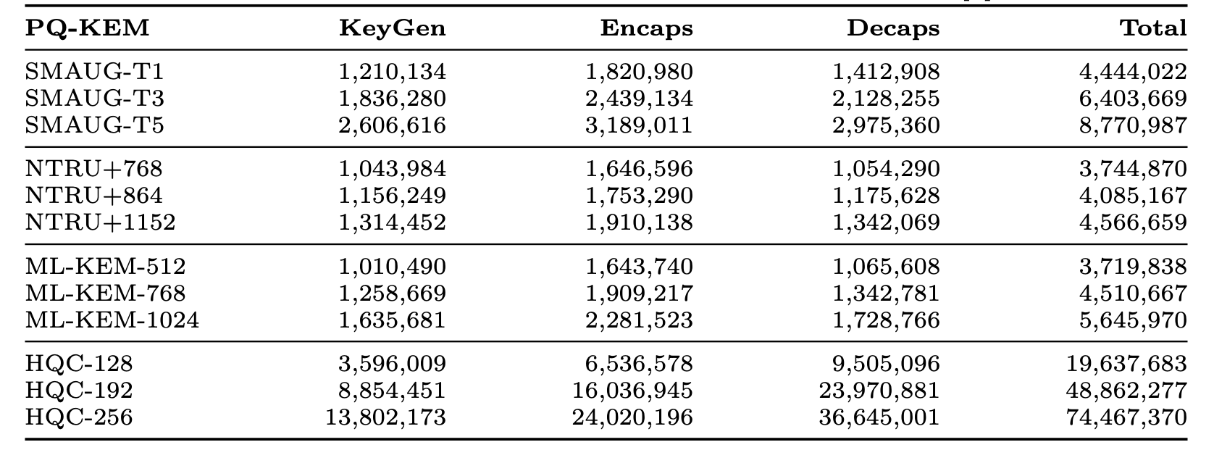
Hybrid KEM Performance on Cortex-M4
With X25519 fixed as the classical component, performance differences are driven mainly by the selected PQ KEM.
ML-KEM, NTRU+, and SMAUG-T fall within a comparable range of 3.72–8.77 M total cycles.
HQC requires 19.64–74.47 M cycles, partly reflecting the additional Hash-CT hashing cost of its large ciphertext.
Total represents aggregate computational work, not protocol latency.
Table 1 Hash-CT hybrid KEM measurements on Cortex-M4 (PQ+X25519)

Slide 13
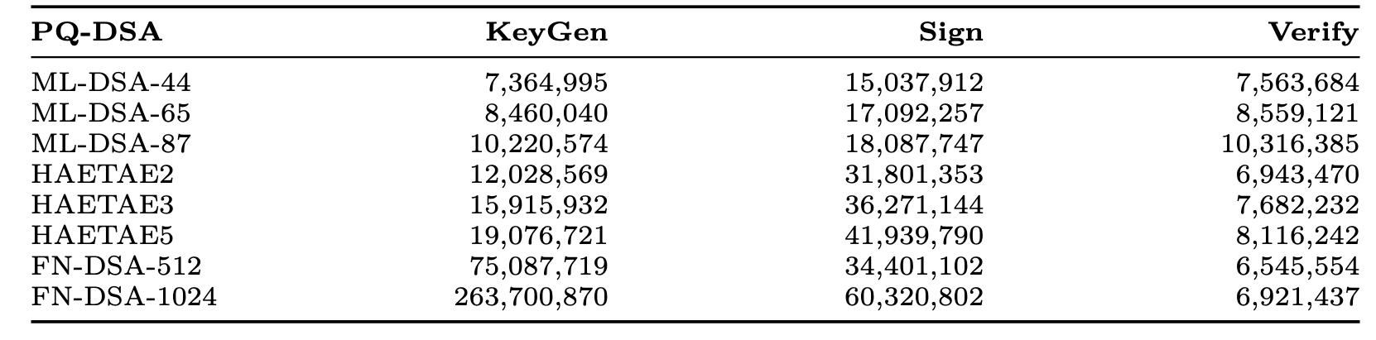
Hybrid Signature Performance on Cortex-M4
The dominant cost component varies across signature families.
ML-DSA provides the lowest signing cost: 15.04–18.09 M cycles.
FN-DSA verifies in 6.55–6.92 M cycles, but key generation reaches 75.09–263.70 M cycles.
Table 2 Primary hybrid DSA measurements on Cortex-M4(PQ+Ed25519)

Slide 14
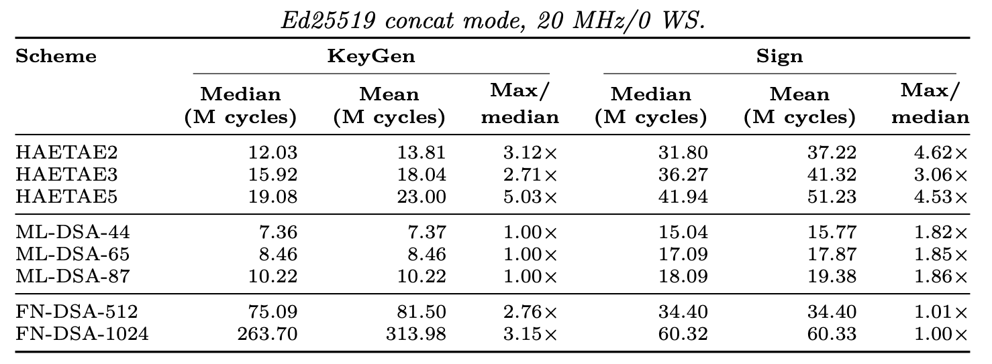
Observed Kengen and Signing-Time Variability
Reporting medians alone can hide substantial rejection-sampling variability.
HAETAE shows the widest observed spread: up to 5.03× for KeyGen and 4.62× for signing.
FN-DSA signing shows little observed variability, with max/median ≤ 1.01×.
Table 3 Observed key-generation and signing variability(N=100)

Slide 15
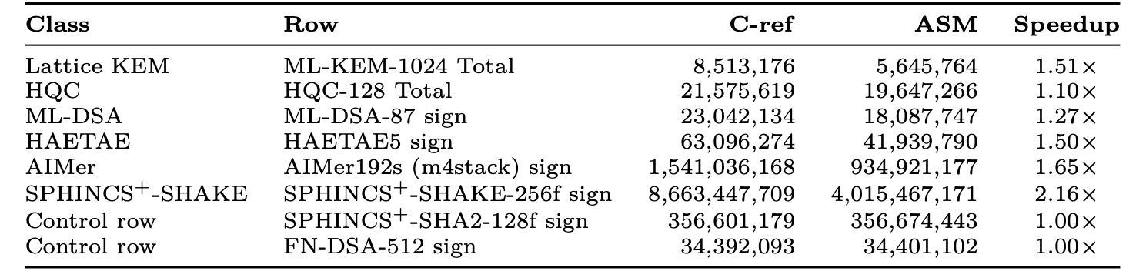
Sensitivity to the Keccak Backend
A shared Keccak backend affects multiple schemes without changing their arithmetic code.
SHAKE-intensive schemes benefit most from the assembly backend.
Speedup reaches 2.16× for SPHINCS+-SHAKE-256f, while control configurations remain at 1.00×.
Table 4 Keccak-f[1600] backend attribution

Slide 16
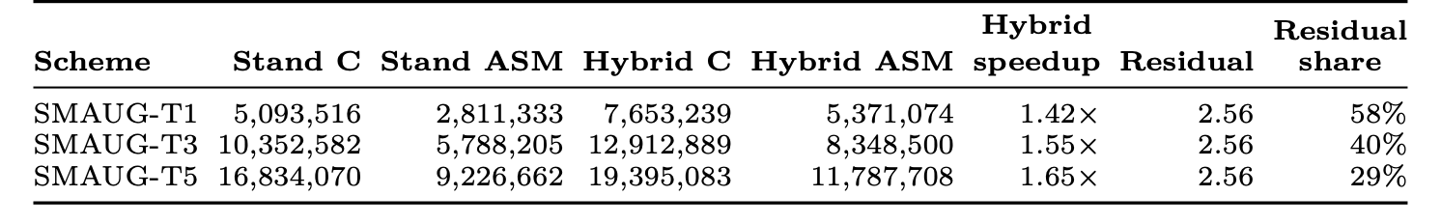
Optimization Dilution in Hybrid SMAUG-T
Primitive-level speedups do not translate directly into equivalent hybrid-level gains.
The standalone SMAUG-T implementation achieves a 1.79–1.82× speedup.
After composition, speedup falls to 1.42–1.65× because 2.56 M cycles of fixed work remain.
Table 5 Standalone and composed costs of the local SMAUG-T backend

Slide 17
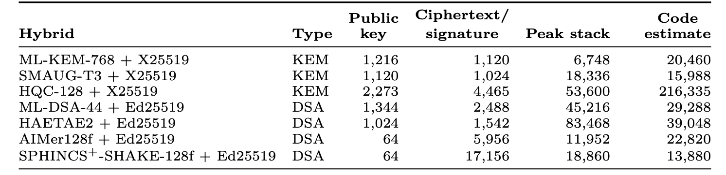
Wire Size and Implementation Footprint
No single composition minimizes wire size, stack, and code simultaneously.
HQC-128 + X25519 has the largest ciphertext and code estimate among the listed KEM compositions.
SPHINCS+-SHAKE-128f + Ed25519 has the largest signature.
HAETAE2 + Ed25519 has the largest measured peak-stack usage: 83,468 bytes.
Table 6 Wire size and implementation footprint of representative compositions

Slide 18
Conclusion
We evaluated KpqC and NIST hybrid KEMs and signatures using a common bare-metal ARM Cortex-M4 harness.
Performance at the hybrid-composition level can differ from
Shared backends affect SHAKE-intensive signatures.
Median-only results can hide observed timing variability.
Classical operations, hashing, and wrapper costs dilute standalone optimization gains.
These observations serve as controls and case studies; they are not claimed to be unique to hybrid composition.
Hybrid-PQC evaluations should document backend provenance and sample counts, and assess optimizations within the full composition.

